Slide 1
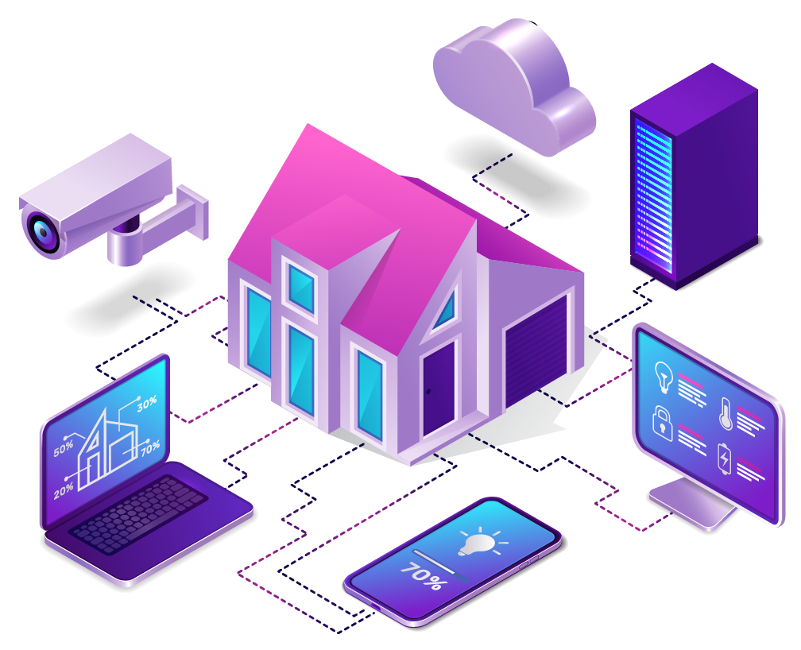
SMART HOME AUTOMATION SYSTEMS
Presented By:
Archita Kundu
Ayaan Dey
Debayan Dutta
Pijush Das

Slide 2
Contents
1
Introduction
2
Review components
3
Advantages Over Existing Systems
6
2
2
Review components
Motivation & Benefits
7
Dependencies
3
3
Review of Various Technologies
8
Challenges
4
4
4
Our Project
9
Future Works
Features of ESP32 Based Smart Home
5
10
Conclusion

Slide 3
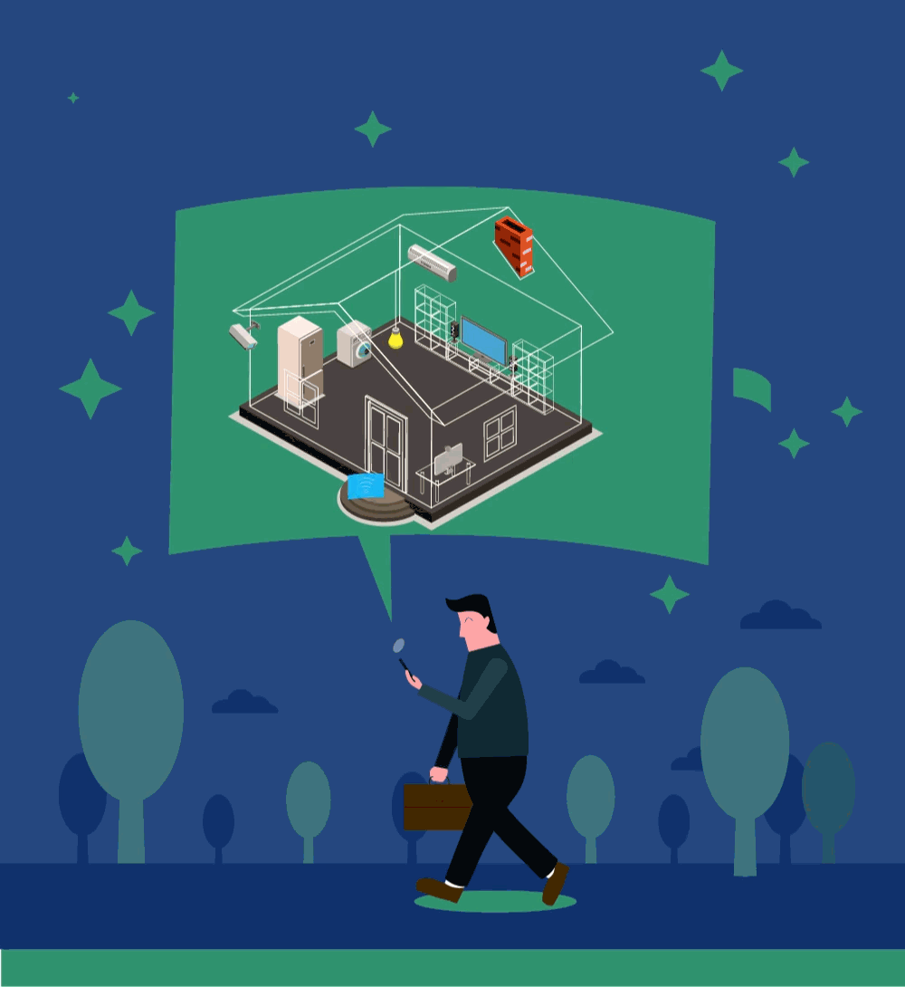
Introduction
The modern home is undergoing a revolution, driven by the desire for increased convenience, improved resource efficiency, and a touch of futuristic ease.
Smart Homes are redefining modern living. These systems connect devices like lights, thermostats, and appliances to a central hub, allowing control via smartphone or voice commands.
This transformation manifests in the growing popularity of Smart Home Automation Systems.

Slide 4

Motivation
A Smart Home that anticipates our needs and adjusts to our lifestyle.
Convenience at our fingertips with voice control and remote monitoring.
Peace of mind knowing our home is secure and energy-efficient.
A living environment that promotes comfort, sustainability, and well-being.
Can be easily accessed by individuals with disabilities and easy control for elderly residents.

Slide 5
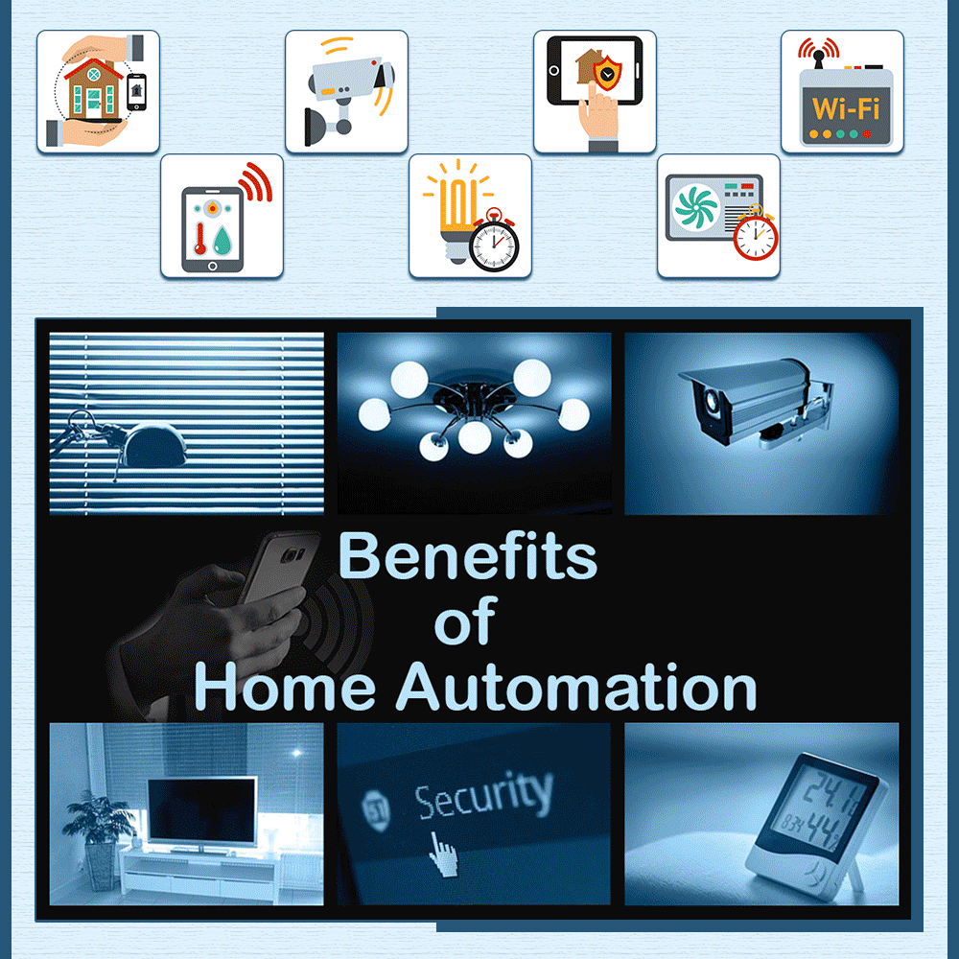
Benefits
Convenience: Automate tasks like lighting, temperature control, and security for a hands-free experience.
Efficiency: Optimize energy consumption by monitoring and adjusting resource usage.
Security: Enhance home security with features like remote monitoring and automated alerts.
Environmental Awareness: Promote sustainability by integrating renewable energy sources and monitoring environmental conditions.

Slide 6
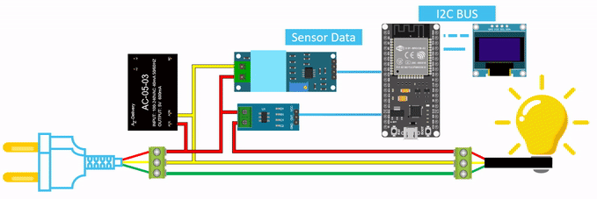
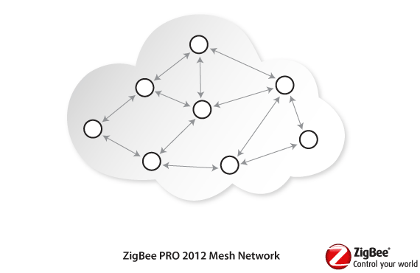
Review of Various Technologies
System Based on ESP32:
Powerful dual-core processor and built-in Wi-Fi & Bluetooth .
Low power consumption.
Supports various sensors.
Open-source development environment and libraries for flexible and cost-effective system creation.
System Based on ZigBee:
Low power consumption.
Low cost, secure and reliable .
Fast and simple setup.
Good wireless range for homes.

Slide 7
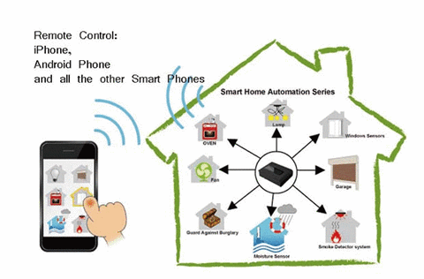
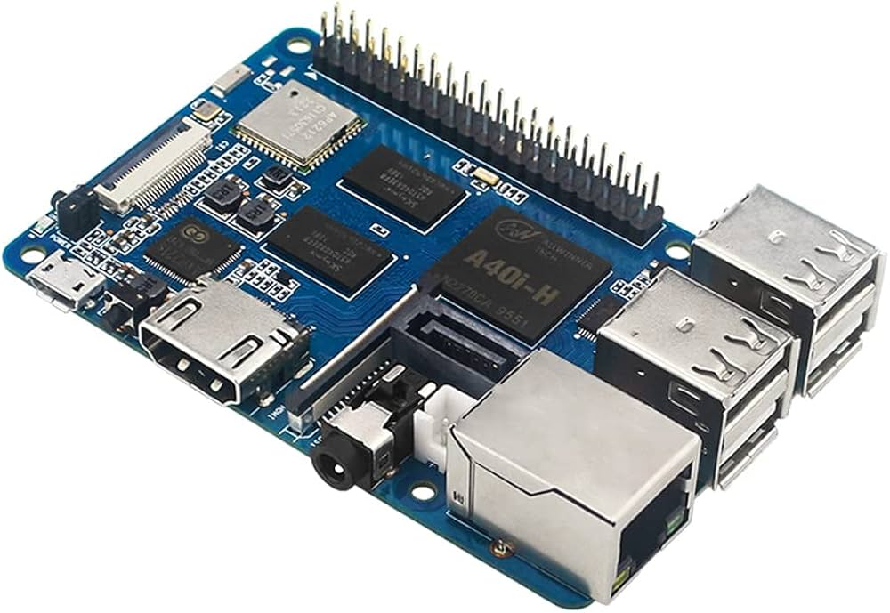
Review of Various Technologies
System Based on Radar:
Works from anywhere around the house (no line of sight needed).
Longer range.
Larger coverage area.
Stronger and more reliable signal.
System Based on Banana Pi:
Cheap, small, and flexible.
Dual-core CPU and GPU.
Open-source software.
Touch screen support.
Camera module compatibility.

Slide 8
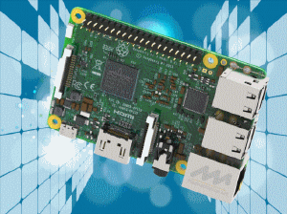
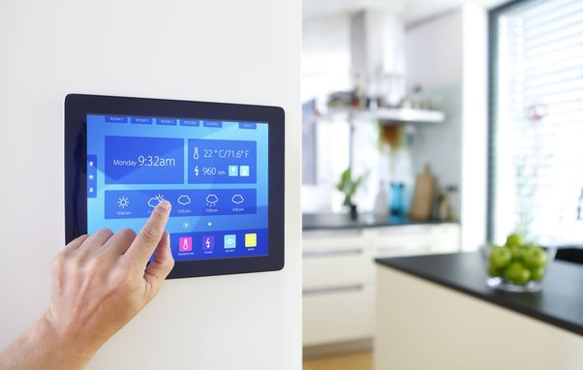
Review of Various Technologies
System Based on Raspberry Pi:
Credit-card sized computer.
Easy interaction with external devices (sensors, actuators).
Wide range of applications including weather stations and security systems.
Smart Home Micro-Computers:
Small computers that automate and control smart home systems.
Easy integration with other circuits.
Connection to a central CPU board.
Use of interchangeable add-on modules.

Slide 9
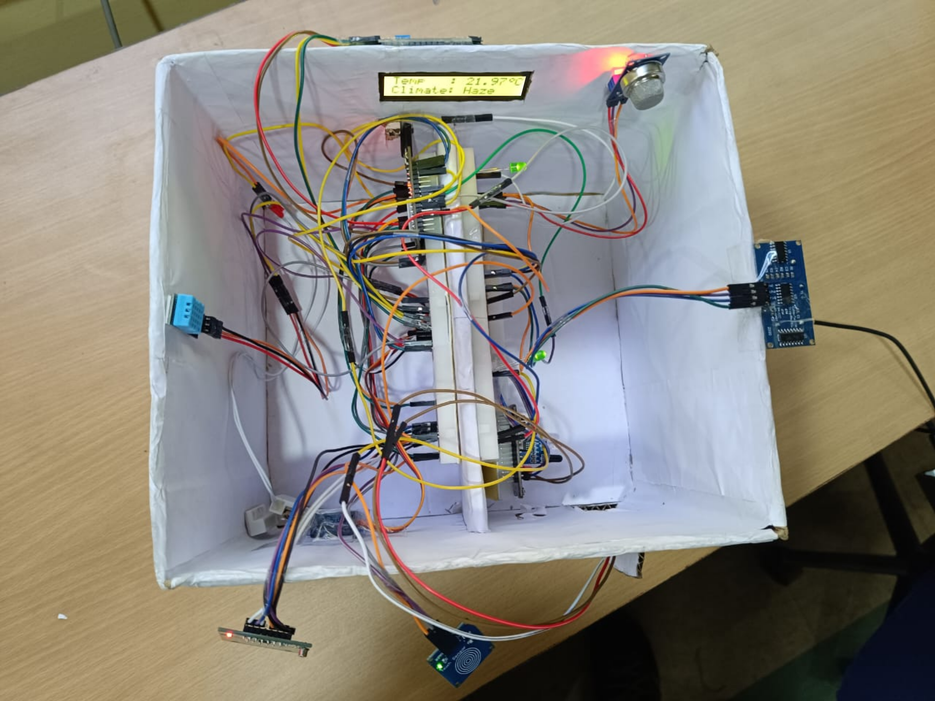
Our Project
I2C Driver
LCD Display
MQ2 Gas Sensor
LED
ESP32 Microcontroller
Jumper Wires
DHT11 Sensor
Ultrasonic Sensor
Breadboard
Servo Motor
IR Sensor
Door Lock Sensor
RFID
Touch Sensor

Slide 10
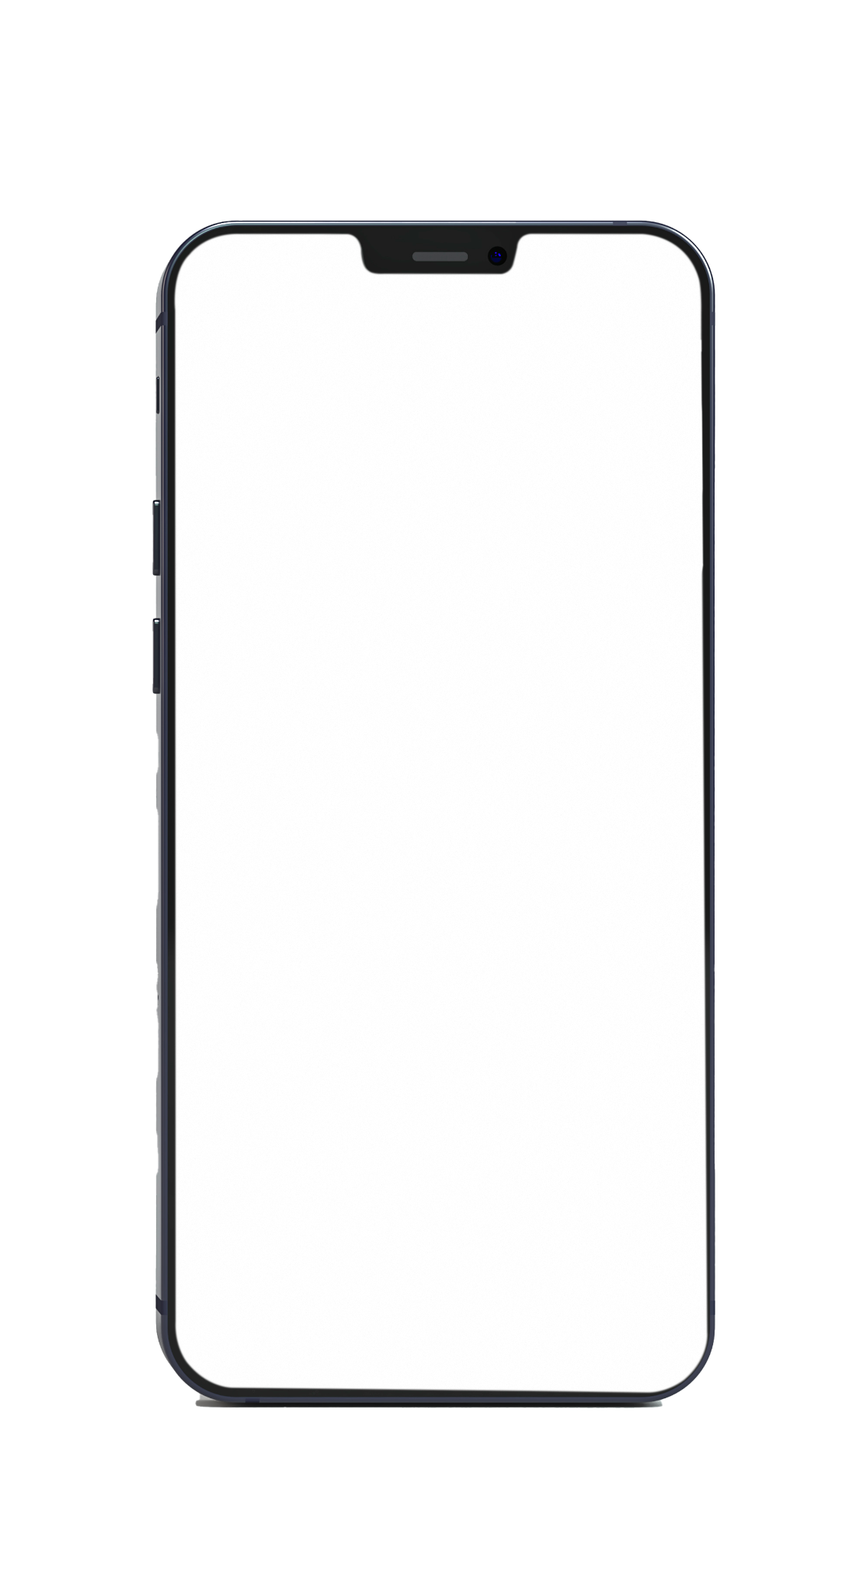

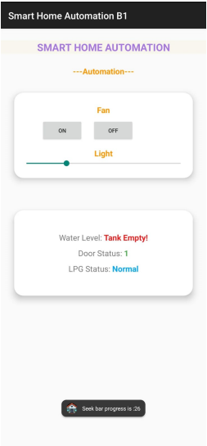
Our Project
Firebase Realtime Database
Mobile Application

Slide 11
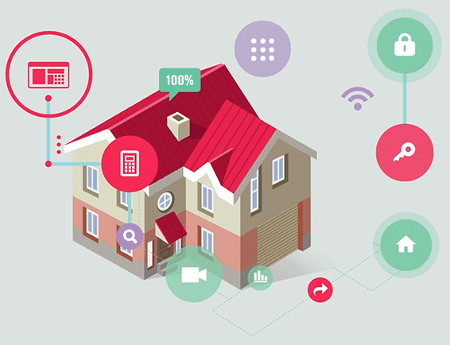
Features of ESP32 Based Smart Home
Automatic lighting and fan control based on occupancy detection using infrared (IR) sensors.
Water level monitoring with real-time alerts for refilling, ensuring a consistent water supply.
Humidity and air quality monitoring with sensor integration, promoting a healthy and comfortable living environment.
Temperature and weather-based recommendations for thermostat adjustments or fan activation, optimizing energy usage.
Compatibility with voice control systems like Amazon Alexa or Google Assistant for hands-free convenience.

Slide 12
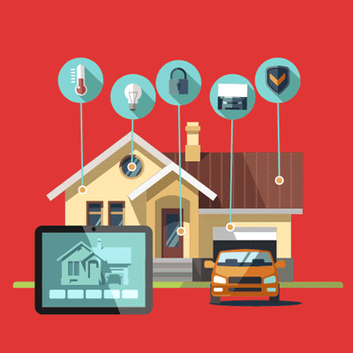
Advantages Over Existing Systems
Focuses on a comprehensive approach to smart home automation rather than isolated functionalities.
Prioritizes affordability and user experience compared to complex and expensive systems.
Enables global access and control of smart home devices from anywhere in the world while ensuring privacy and security.
Offers a user-friendly mobile app interface for remote control and monitoring of your smart home environment.

Slide 13

Dependencies
Hardware:
ESP32 microcontroller board
Sensors (IR, water level, humidity, air quality, temperature)
Actuators (relays for lights and fans, solenoid valve for water control)
Power supply
Software:
ESP32 Integrated Development Environment (IDE)
Libraries for sensor communication and actuator control
Mobile app development platform (optional)

Slide 14

Challenges
Potential Challenges to Consider: Sensor calibration and accuracy: Sensor readings may require calibration to ensure reliable data.
System Complexity: As the number of sensors and actuators increases, the system complexity can grow, requiring careful planning and configuration.
Security Vulnerabilities: Security measures should be implemented to protect the system from unauthorized access.
Power Outages: A backup power source can be considered to ensure system functionality during power cuts.

Slide 15
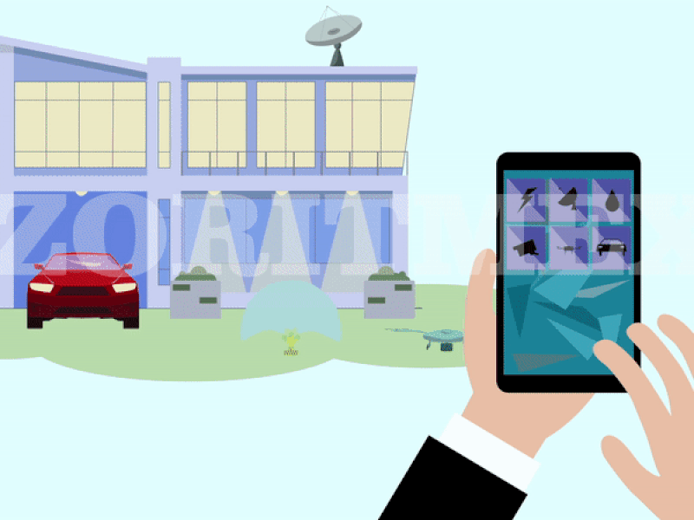
Future Works
Integration with additional smart home devices for a more comprehensive ecosystem.
Advanced machine learning algorithms for personalized automation and predictive maintenance.
Voice control integration with a wider range of smart home systems and virtual assistants.
Biometric authentication for enhanced security measures.
Energy harvesting techniques for sustainable power supply.

Slide 16
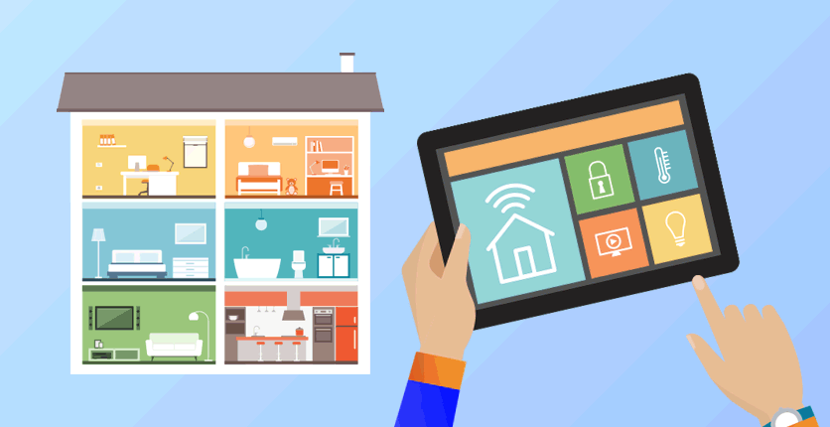
Conclusion
Smart home automation with the various technologies presents a promising future for intelligent living environments.
The proposed system offers a comprehensive and user-friendly solution that prioritizes convenience, efficiency, security, and environmental awareness.
As technology continues to evolve, we can expect even more advanced and integrated smart home systems to emerge, transforming our homes into truly intelligent and sustainable spaces.

Slide 17
Archita Kundu
archita_k.it2021@msit.edu.in
Ayaan Dey ayaan_d.it2021@msit.edu.in
Debayan Dutta debayan_d.it2021@msit.edu.in
Pijush Das
pijush_d.it2021@msit.edu.in
Thank You

